Slide 1
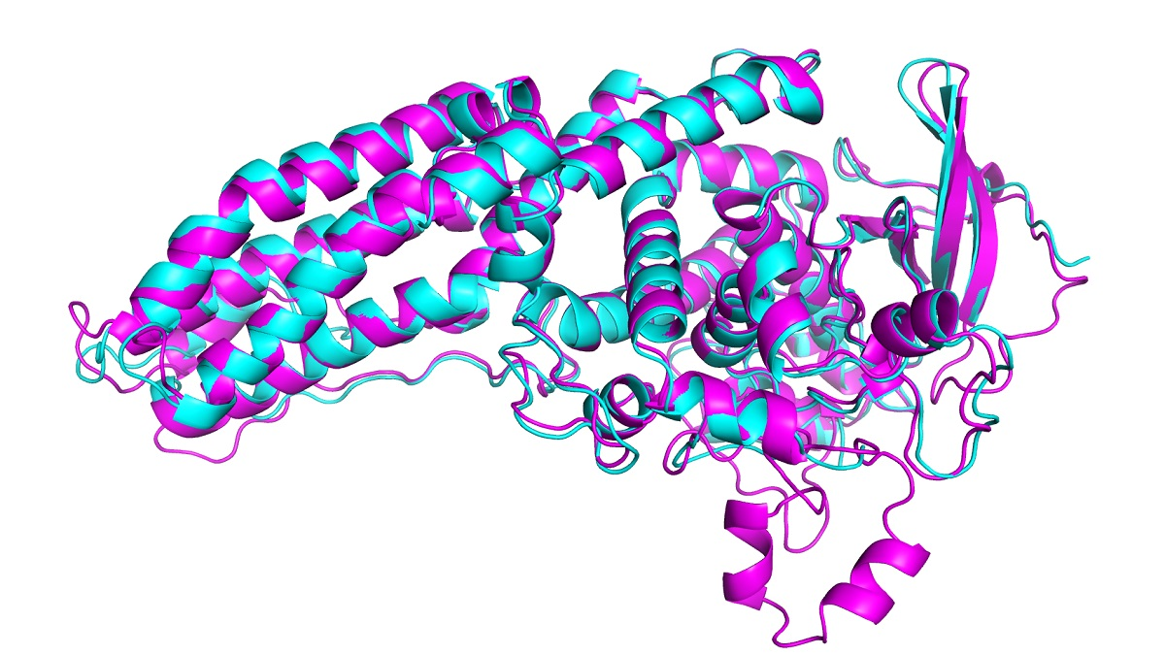
Protein folding problem
Chareyre Adam

Slide 2
Summary I) Introduction a) Some definitions b) What purpose c) Some numbers (we are scientists after all) II) What is the problem ? III) Who solve it and how ? II) Conclusion

Slide 3

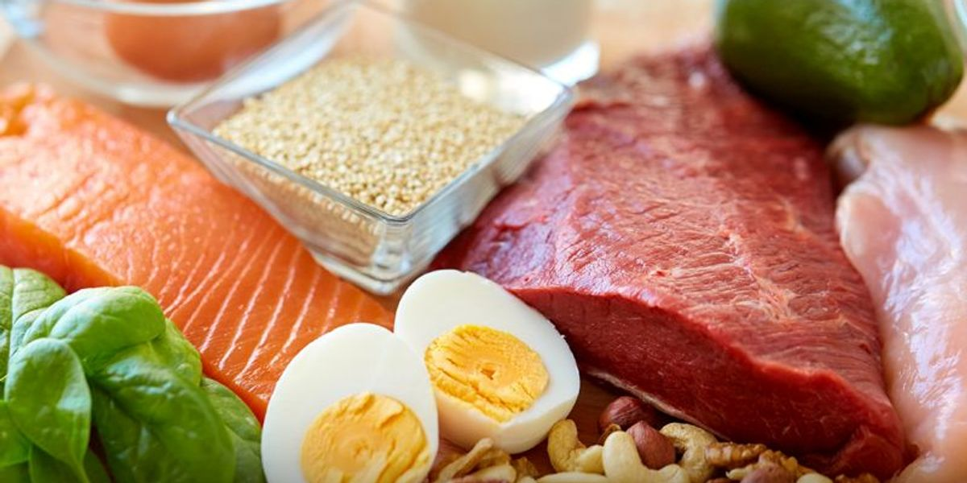
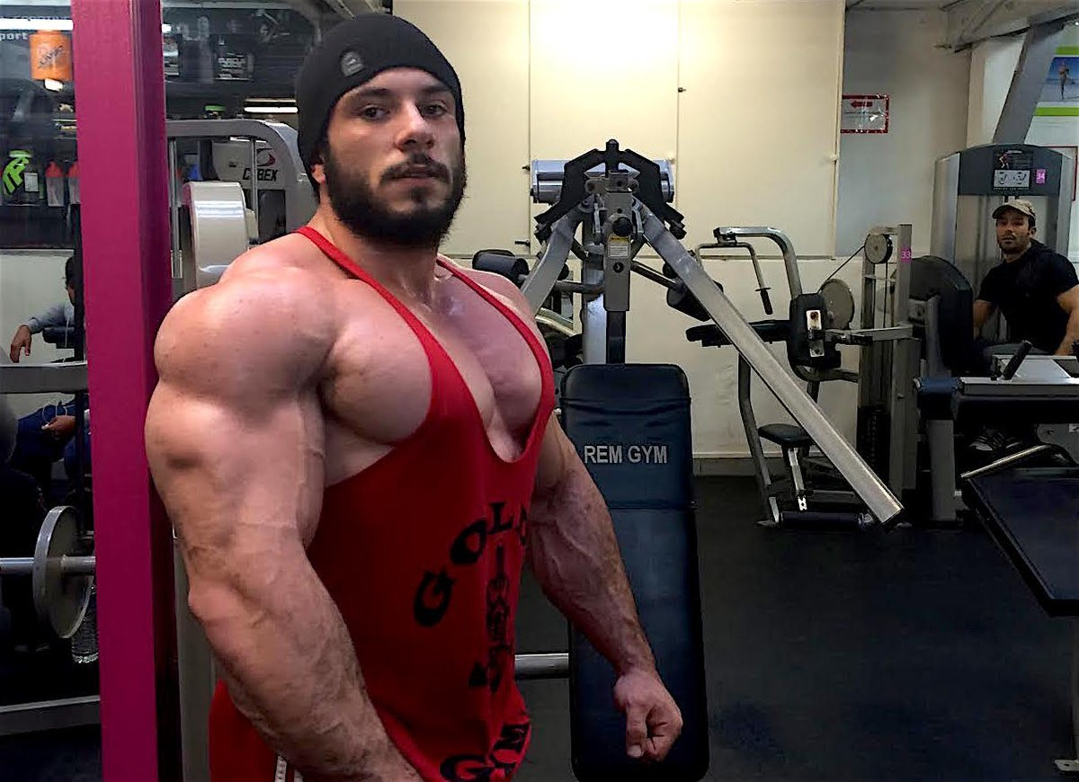
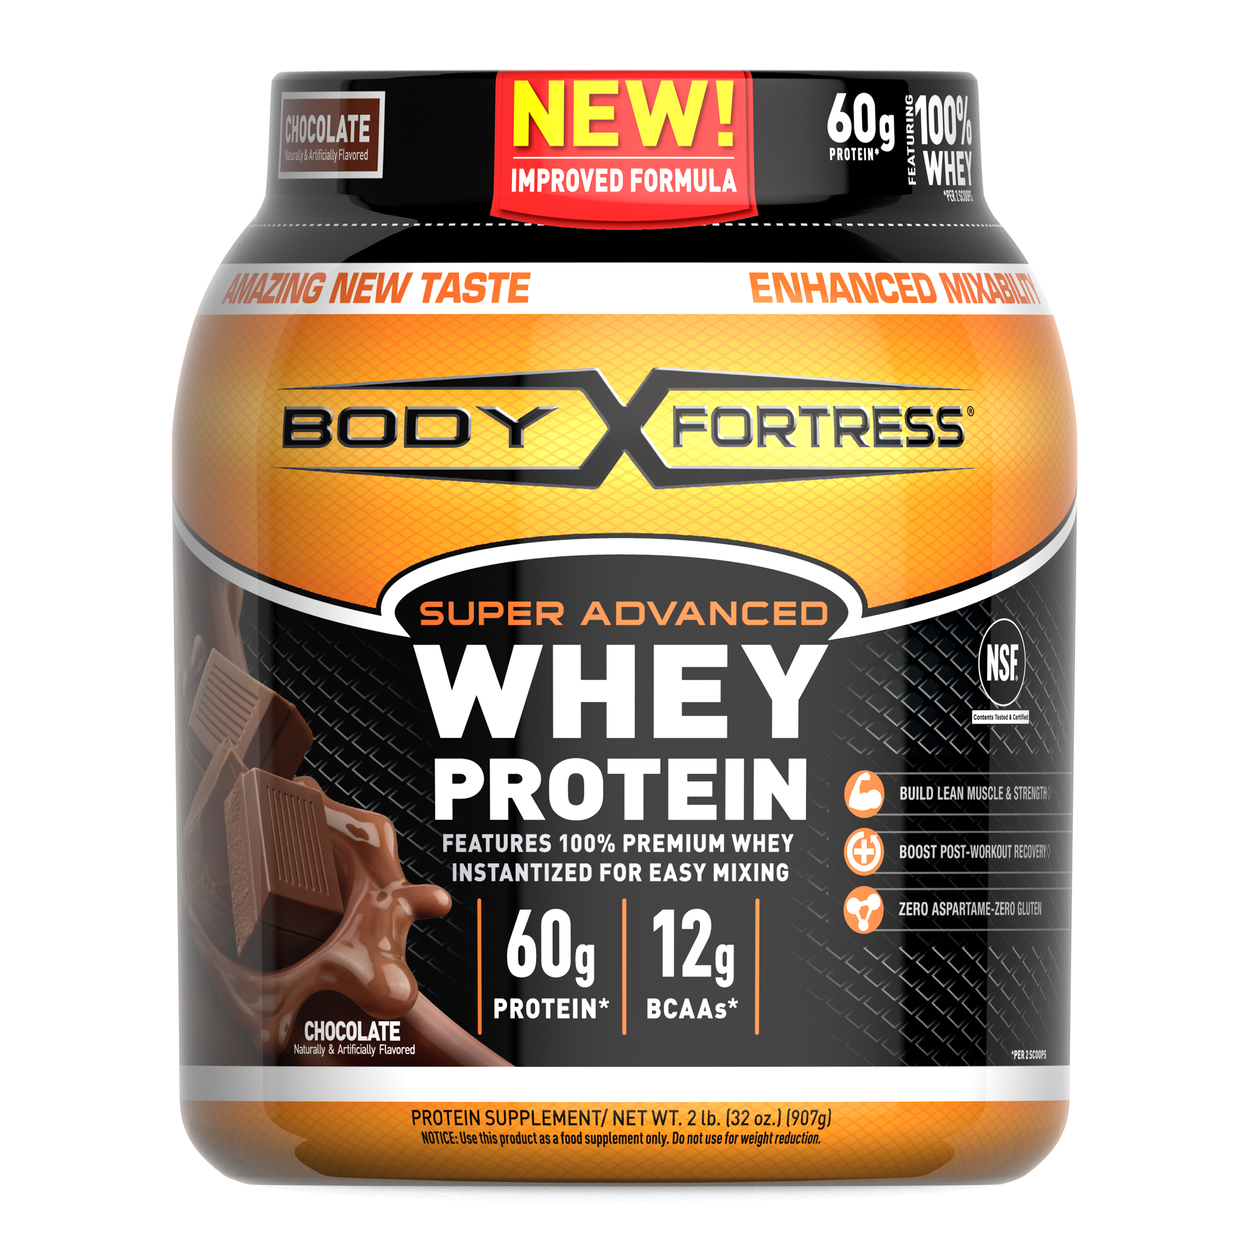
What is a protein ?
In the common language, proteins are nutrients found in food

Slide 4
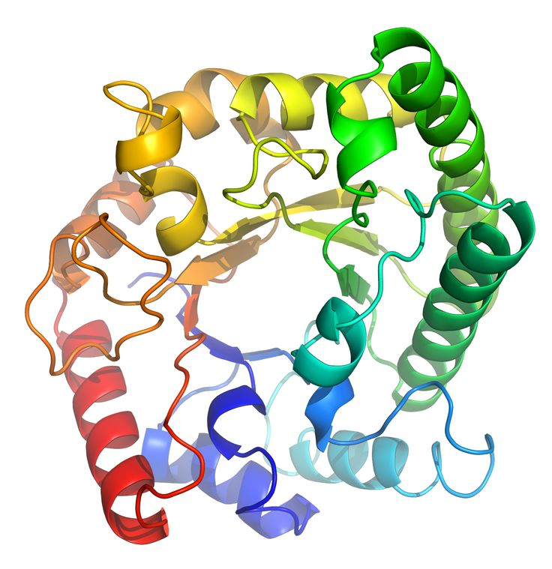

But the truth is different…
In biology, it’s fat molecule

Slide 5
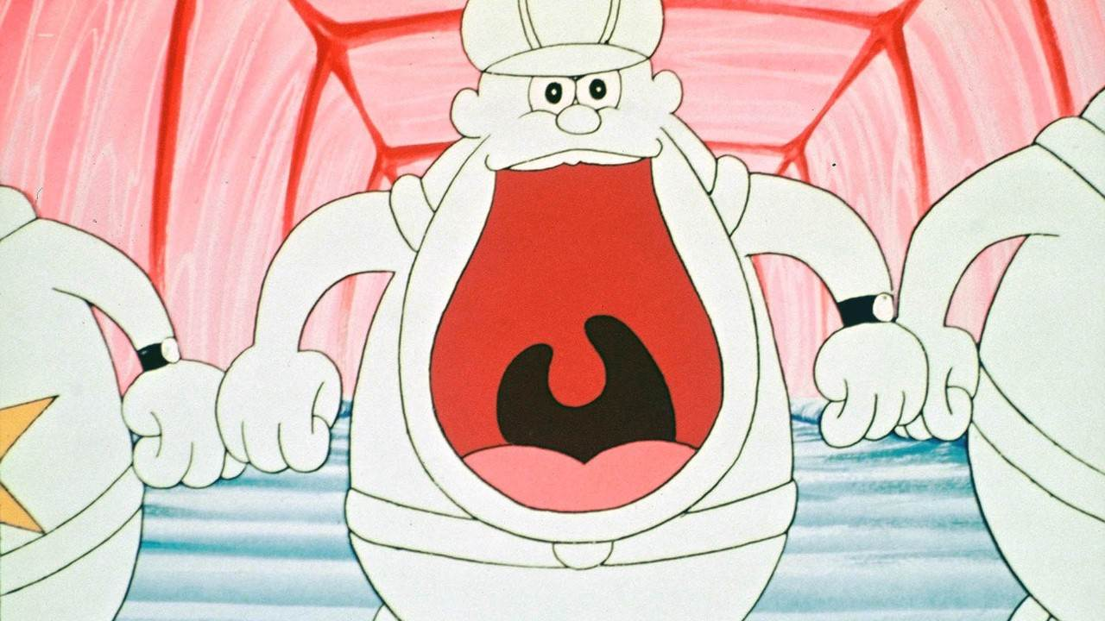
But the truth is different…
Our body transform the proteins that we eat to into other protein to use them:

Slide 6
What is its purpose ?
Cell building
Moving muscle
- Controlling metabolism
Create antibodies

Slide 7

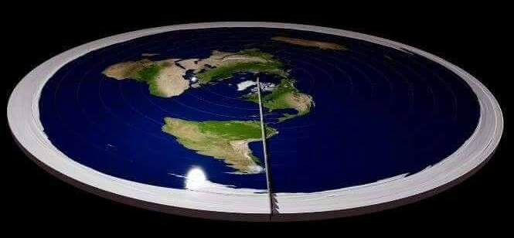
Some numbers…
10 000 proteins
In the human
Body:
It’s represent 60% of our body (without the water)
200 millions on the earth !!

Slide 8
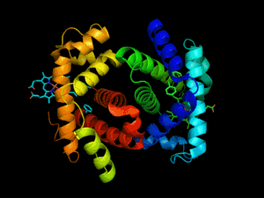
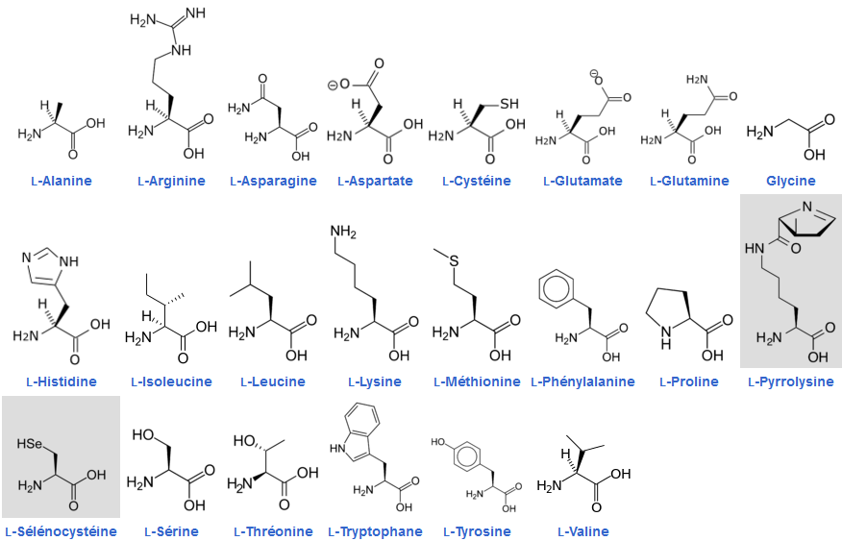
The shape of a protein tell what she need to do
A protein is a set of amino acids

Slide 9
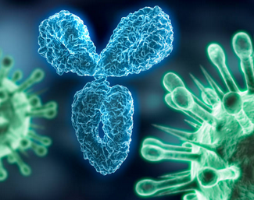
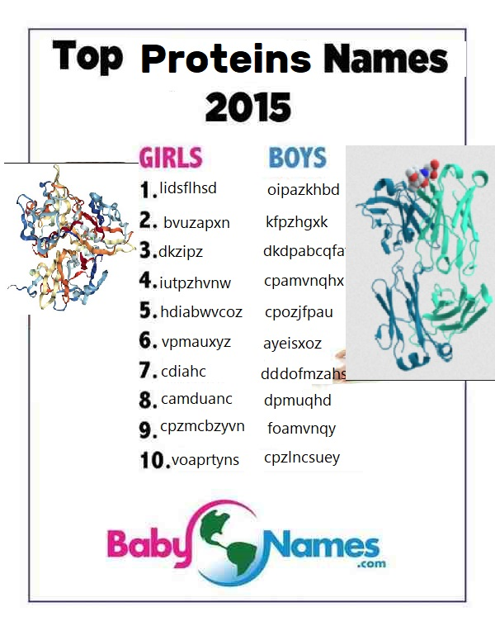
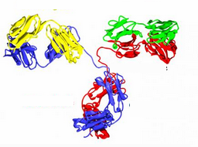
Each amino acid have a name
Protein usage

Slide 10
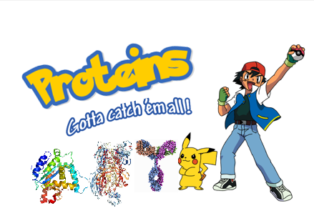
The goal is to find the most possible protein shape
Actually:
170k/200 000k
Shapes were
found

Slide 11
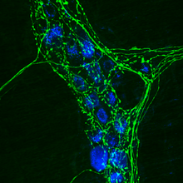
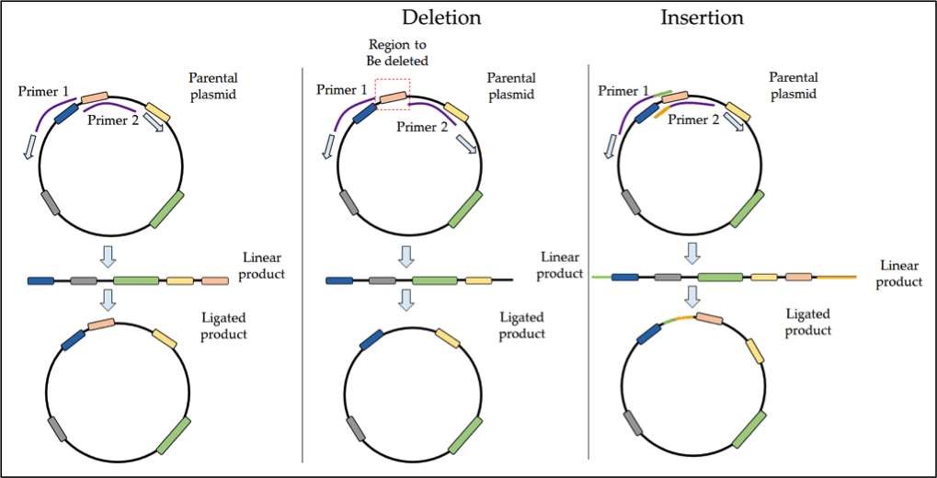
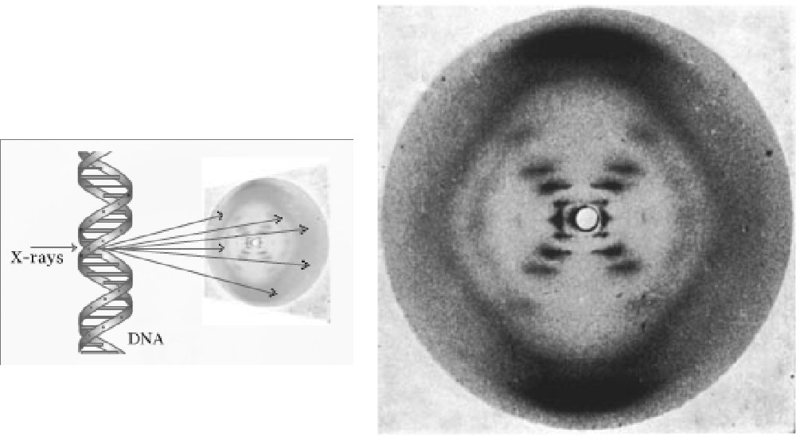
Current methods:
Immunohistoc-hemistry
Site-directed mutagenesis
X-ray crystallography

Slide 12
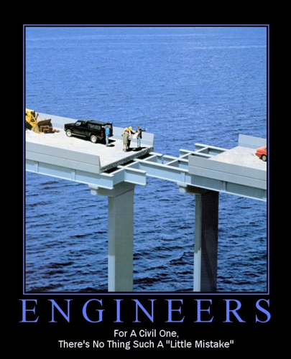

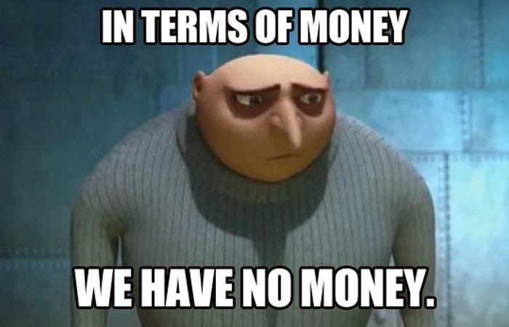
BUT
It’s costly
It’s take time
Not working each time

Slide 13


How to resolve this lack of time/money ? ASK TO GOOGLE !
How can I resolve this problem Google ?
Let users work for you ! ☺

Slide 14

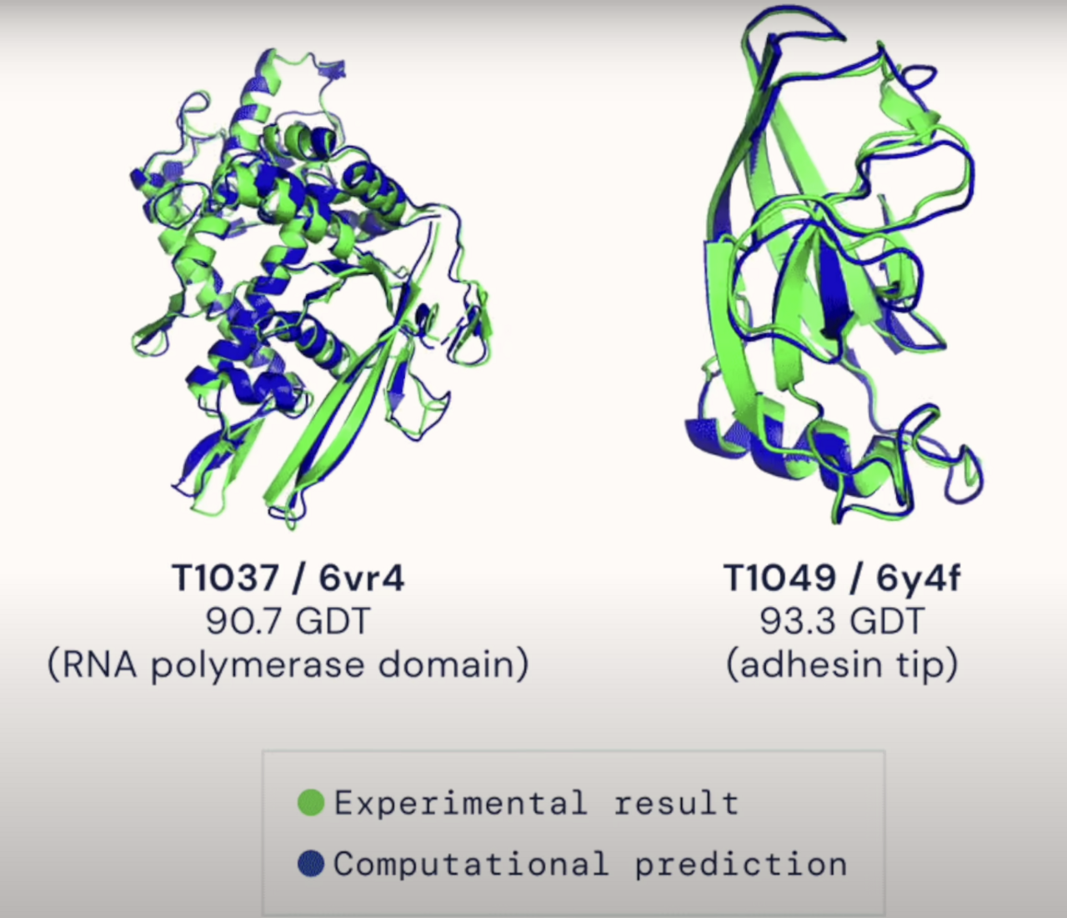
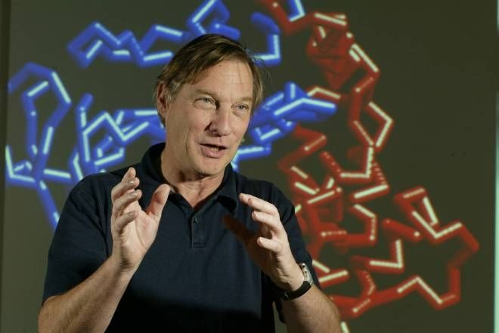
How to score ?
CASP competiton

Slide 15
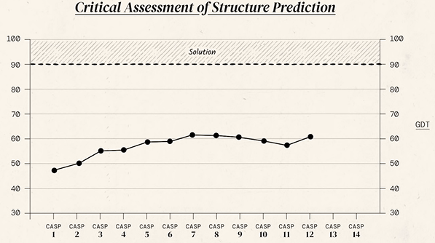
CASP results from 1994 to 2016

Slide 16
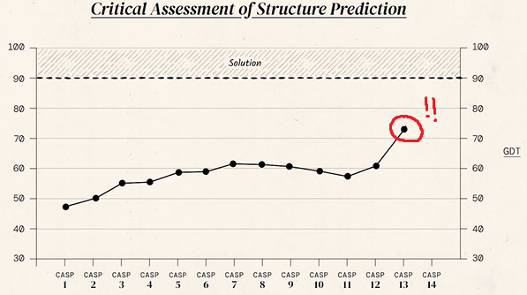
But, on CASP 13, something append

Slide 17

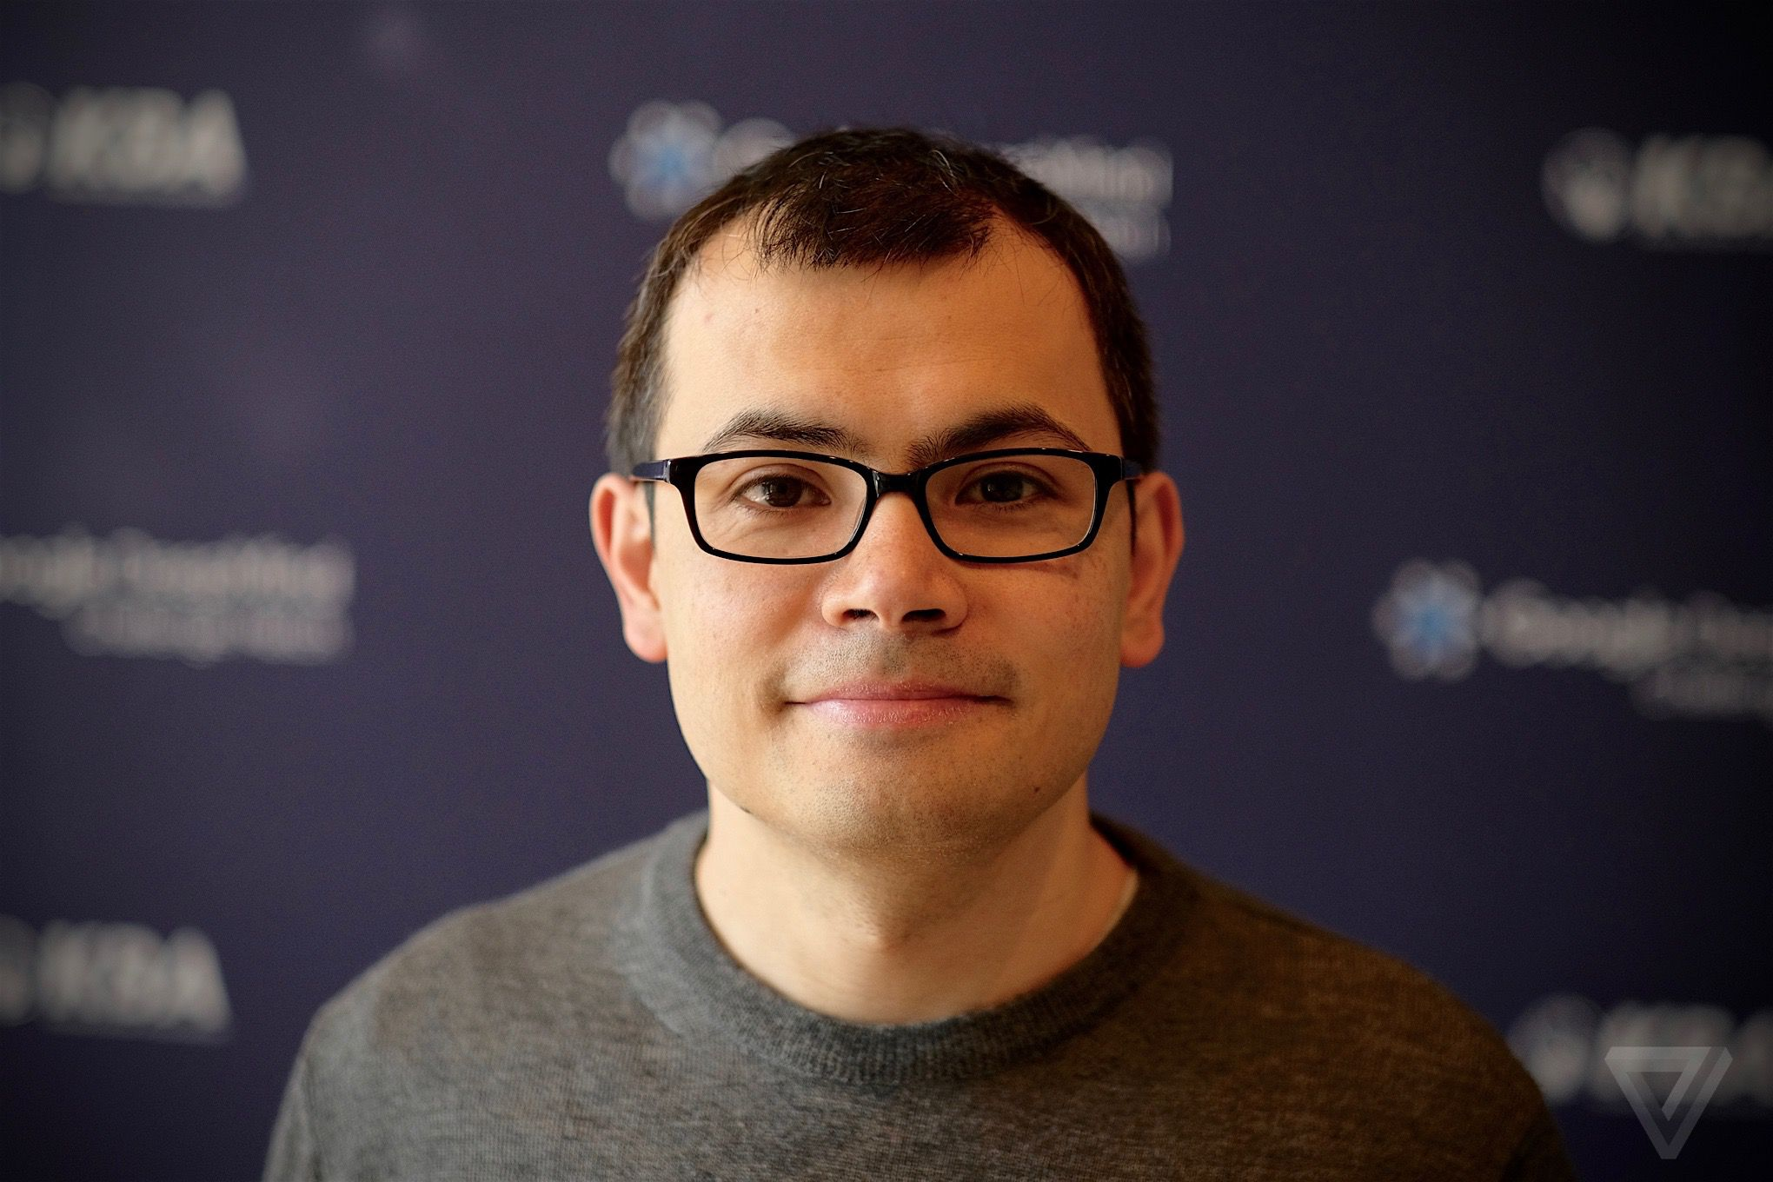
An algorithm named « AlphaFold» appeared
Hassabis Demis

Slide 18
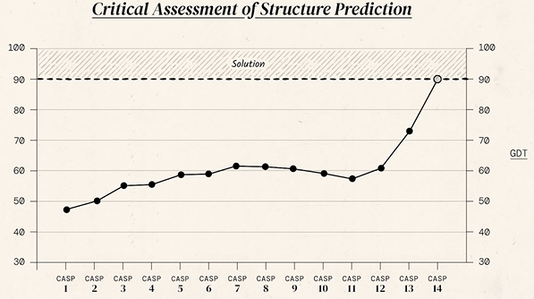
And on CASP 14…

Slide 19
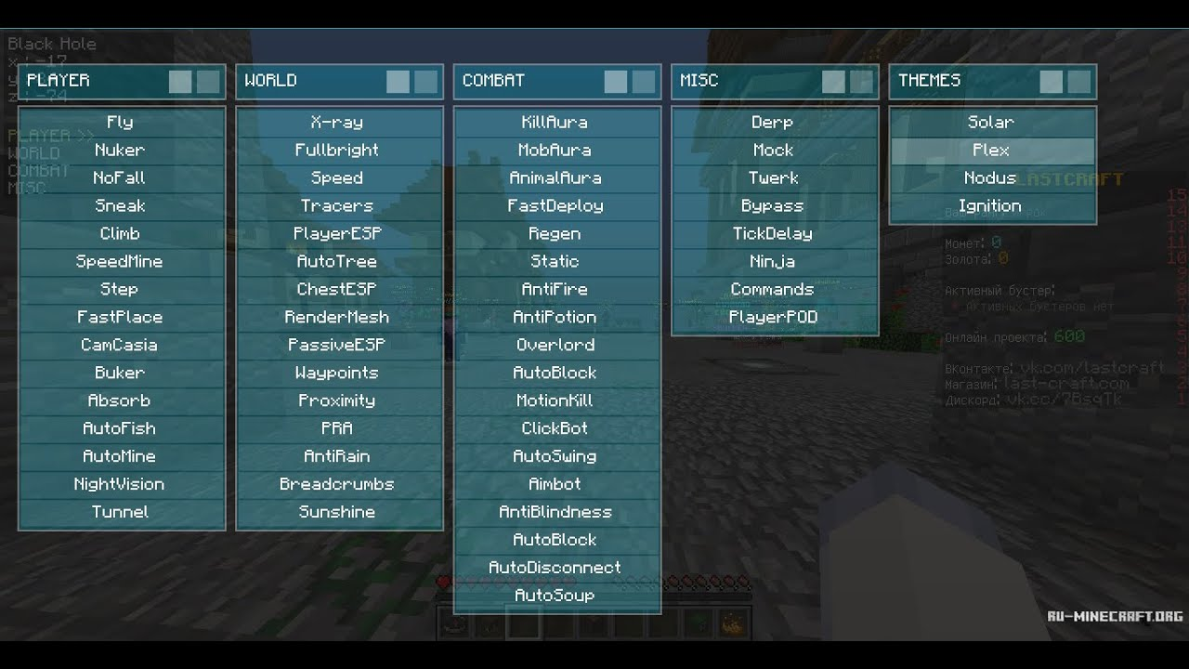
Cheat ??

Slide 20
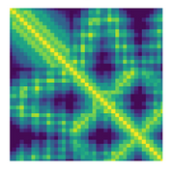
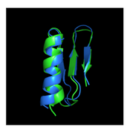
A little introduction of how this is working
Step 1: Amino-acids sequences to distance matrix
Step 1: distance matrix to the 3D representation
osfhdofpsofdsqfsd

Slide 21
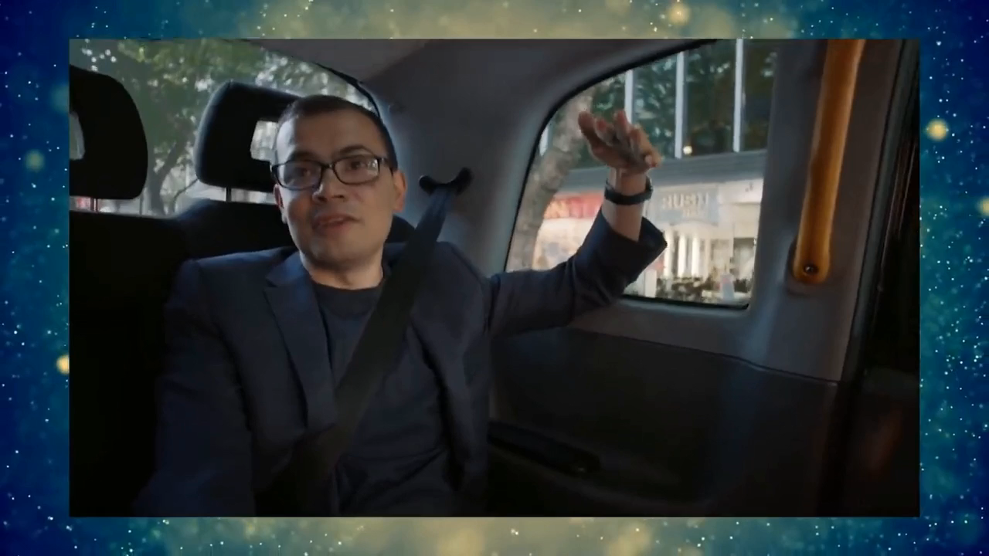
Video time

Slide 22
Conclusion

Slide 23

Question ??

Slide 24
Debate question:
Should individuals have the possibility to access treatments for protein misfolding diseases even if they are not fully understood or proven to be effective? (reminder: yes/no answers need a little bit of development ☺ )

Slide 25
Sources:
https://www.youtube.com/ https://fr.wikipedia.org/ https://predictioncenter.org/casp15/index.cgi

